Slide 1
Cost and Advertisement Data Analysis Project
Isaac Heeseok Joo

Slide 2
Background
XYZ advertises on TV
XYZ collected data from customers if they saw XYZ’s ads and where they saw it if they have
XYZ wants to know which network is most cost efficient and how much it costs to acquire customers

Slide 3
Relevant Terminology
Spend | Amount of money spent to air the ad
Lift | Number of visits attributed to the ad. Calculated by Total traffic - Expected number of natural traffic (Baseline)
Purchase | Number of purchases from the exit survey data
Count | Number of times the ad aired on a network
Cost per Visitor (CPV) | Amount of money spent per visitor (Spend/Lift)
Conversion Rate (CR) | Purchases made per visit attributed to the ad (Purchase/Lift)
Cost per Acquisition (CPA) | Amount of money spent per conversion (Spend/Purchase)

Slide 4
Data Provided
3 Excel Spreadsheets were provided
Purchase Exit Survey Data: Survey data filled by customers who visited XYZ website because of the ads and purchased the product
Airing Data: Data on which network and when the ads aired, and associated Spend and Lift
Lookup Data: Reference table on the names of network and their abbreviations to link Survey data and Airing data

Slide 5
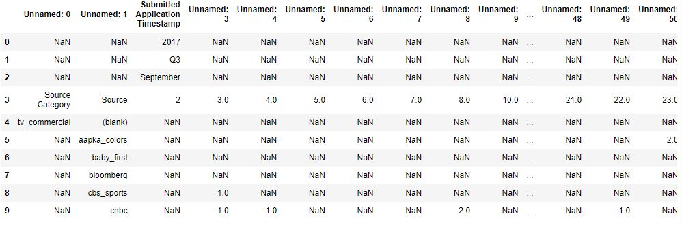
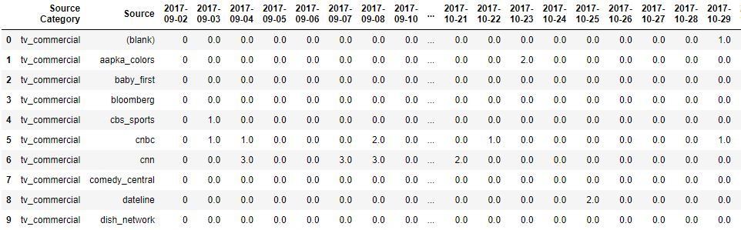
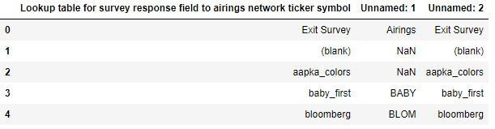
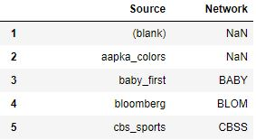
Data Formatting/Data Cleaning
Survey_data: the Excel file was designed to look better on Excel, but unusable in Python. The data was formatted to make it workable in Python
Lookup_data: This reference data had duplicate column and header was not named

Slide 6
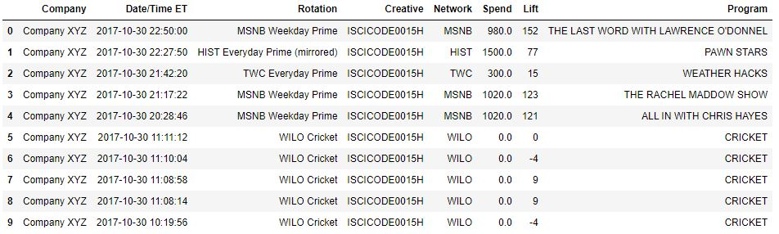
Data Formatting/Data Cleaning
Airing_data: It was already in a workable format for Python. Airing data did not need formatting, but there are some points to note about this data
ZEETV and CNBCWORLD do not seem to label their program
MSNB is missing one program name, but it seems to be a simple error
Program names are not relevant in this case study, but a note for future analysis involving individual programs

Slide 7
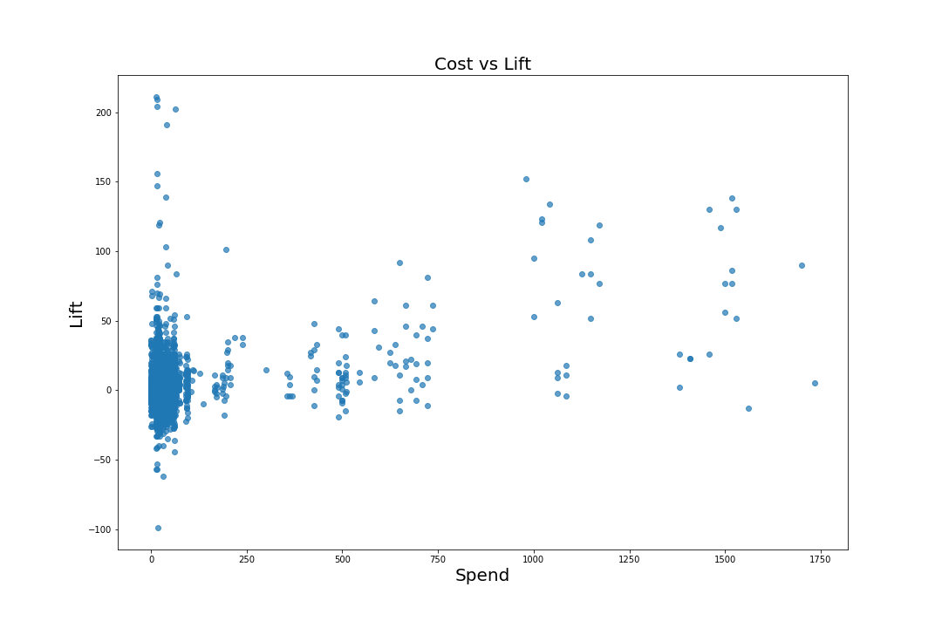
Exploratory Data Analysis
Cost vs Lift
Spend vs Lift plot to see if there is any correlation
Large number of points concentrated near the origin
Huge deviation in lift near (Spend = 0) making data noisy

Slide 8
Exploratory Data Analysis
Cost vs Lift
Spend vs Lift plot to see if there is any correlation
Large number of points concentrated near the origin
Huge deviation in lift near (Spend = 0) making data noisy

Slide 9
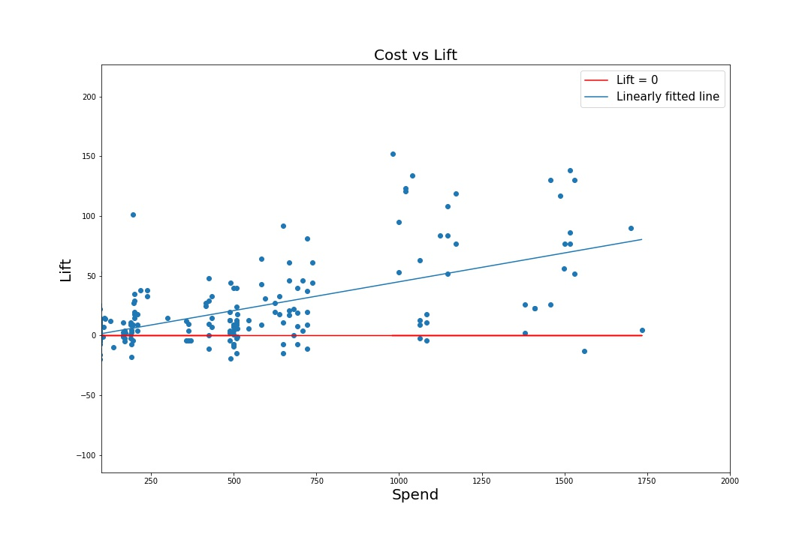
Exploratory Data Analysis
Cost vs Lift Zoomed In
Zoomed in to look at points (Spend > 100)
Noise is significantly reduced as Spend increases
Increasing Spend provides reasonable causality for Lift to increase
Weak but apparent positive correlation between Spend and Lift
This is intuitive since more money you spend on ads will most likely bring more people to the website

Slide 10
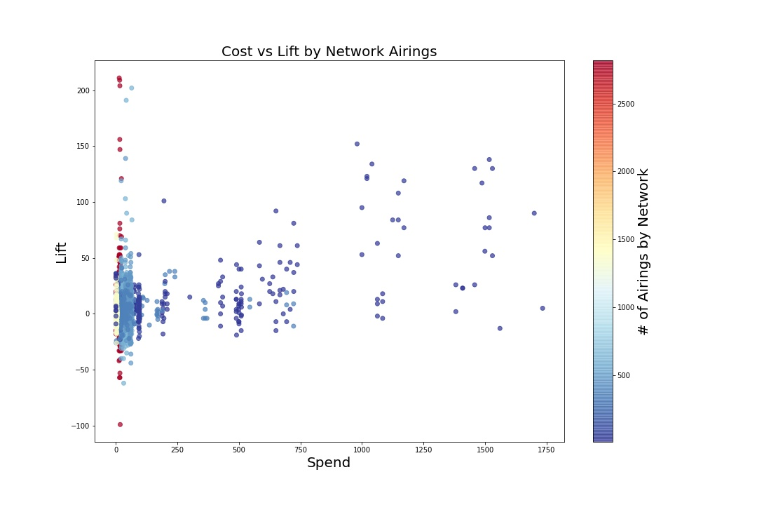
Exploratory Data Analysis
Relationship between Noise and Number of Airing
Color indicates number of times the ad aired on a network
Red - More Airing
Blue - Less Airing
Increase in number of airing results in more noise in Lift
Also can see that less money spent correlates to more airing
This makes sense because low spending leads to high number of airing, which could result in large deviation in lift

Slide 11
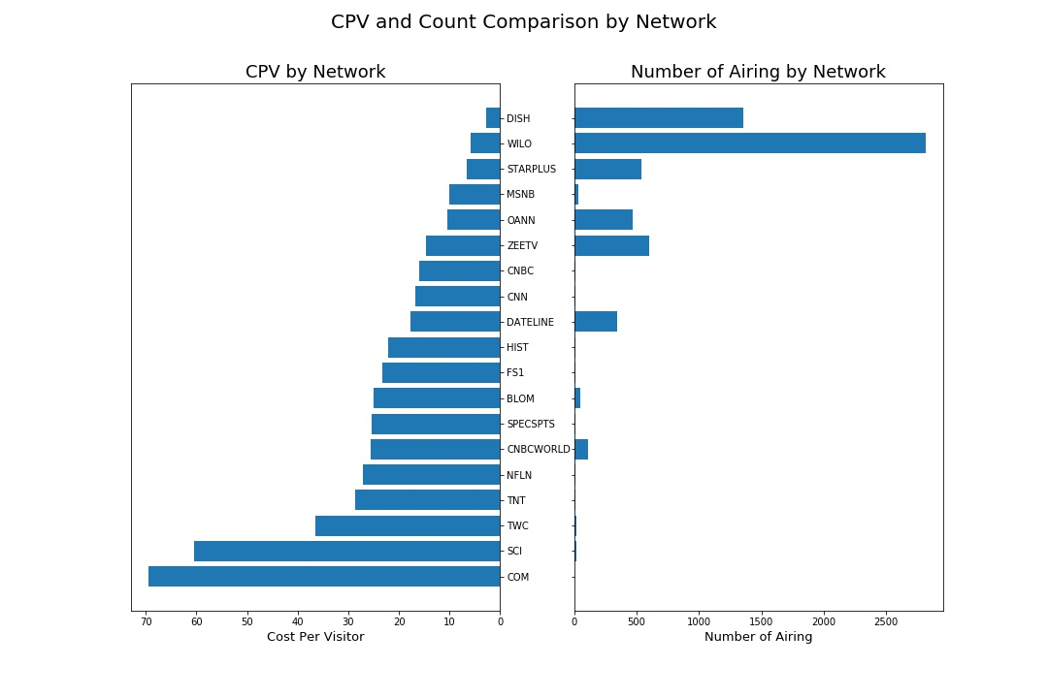
Cost Per Visitor (CPV)
Cost per Visitor (CPV) is amount of money spent per visitor (Spend/Lift)
More airing naturally leads to more lift
WILO has large amount of airing and this shear number of airing could skew the metric
Networks like WILO and DISH seem to return highest efficiency by costing less per visitor, but when you look at the number of these networks aired the ad, it confirms previous statement where less cost -> more airing, thus causing more efficient CPV
CPV of entire dataset
10.80

Slide 12
Data formatting for CR and CPA
New dataframe was created for convenience since we have to work across two datasets
Pandas merging function works like JOIN in SQL
Merged Survey_data and Airing_data on ‘Source’ and ‘Network’ by using reference from Lookup_data
The data where networks have Airing data were labeled as ‘Real’, and the data that includes networks that have Purchase data but not the Airing data were labeled as ‘Estimate’
Missing Data: Used average Conversion Rate and Cost Per Acquisition from Real data to obtain missing ‘Spend’ and ‘Lift’ values for networks in Estimate data instead of using average of total spend or lift from Airing data
Average CR and CPA calculated from Real data were used to get reasonable spend and lift correlating to the purchase number of the networks
In this report, we only deal with existing Real data, but estimated data is available in the Jupyter Notebook

Slide 13
Data formatting for CR and CPA
Metric Function
Created a function called ‘metric(df)’ that calculates and appends Cost per Visitor, Conversion Rate, and Cost per Acquisition after it went through cleaning and formatting process
Average of Spend, Lift, CPV, CR, and CPA are calculated by dividing number of times the ad aired on a network (ex. Average Spend = Average amount of money spent per airing of ad)

Slide 14
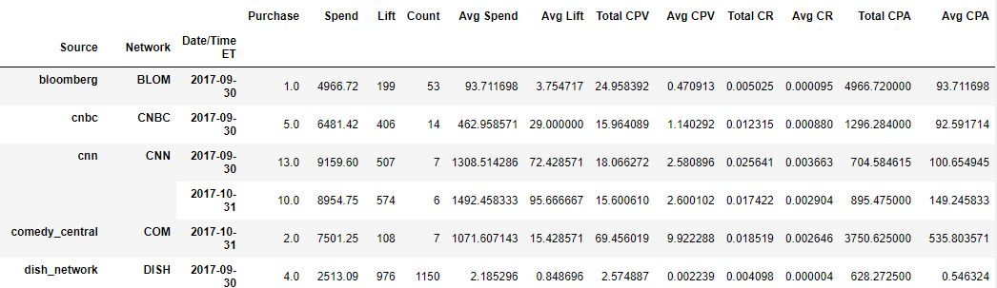
Data formatting for CR and CPA
Formatting produces following multiindex dataframe with ‘Source’, ‘Network’, ‘Date/Time ET’ as indices

Slide 15
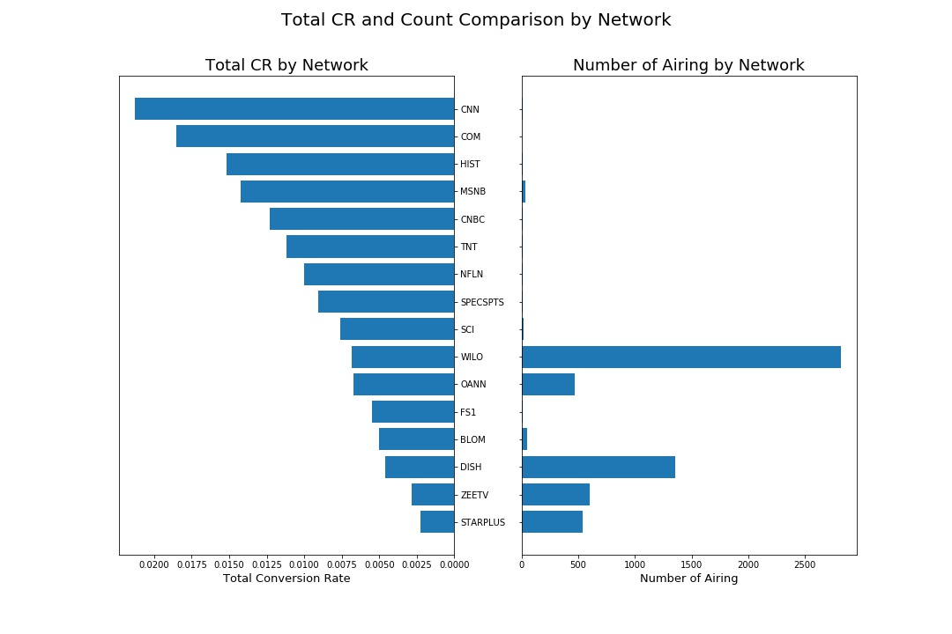
Conversion Rate
CR vs Number of Airing
Conversion Rate (CR) is the Purchase made per visitor by the ads (Purchase/Lift)
CR does not seem to correlate with the amount of airing
CNN, COM, and HIST have shown greatest CR with few airings
WILO, DISH seem to be inefficient compared to the number of airings
CR of entire dataset
0.007540

Slide 16
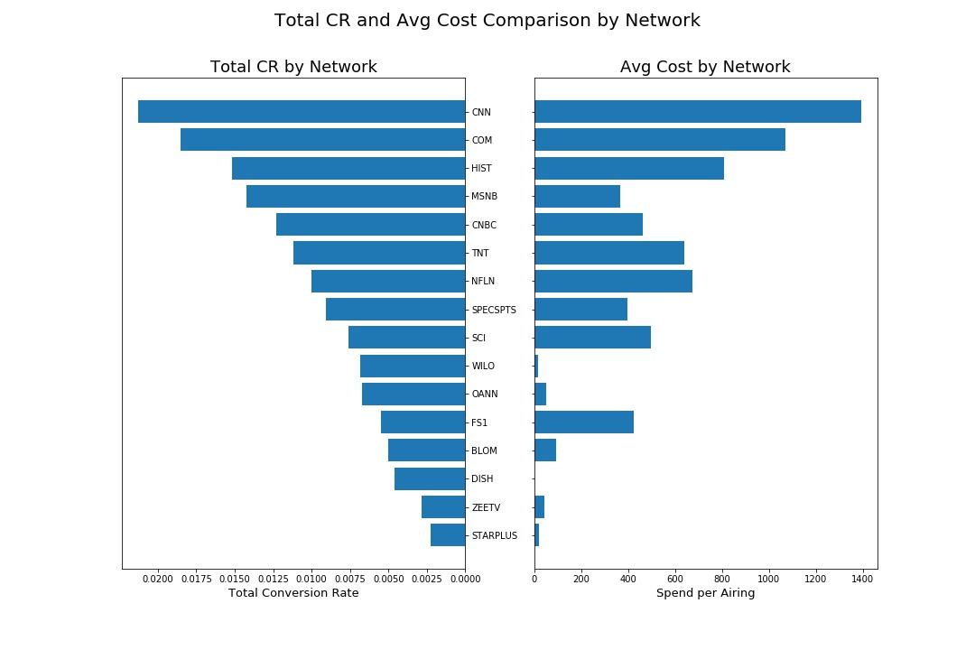
Conversion Rate
CR vs Average Cost
Here we compare Total Conversion Rate with the amount of money spent per airing
There is a definite correlation between CR and Average Spend
More money spent on ads probably means the network is watched by many, thus higher price
Network with more audience also means higher likelihood of purchases from the ads
In this case, MSNB and WILO yields good efficiency based on the money spent
CR of entire dataset
0.007540

Slide 17
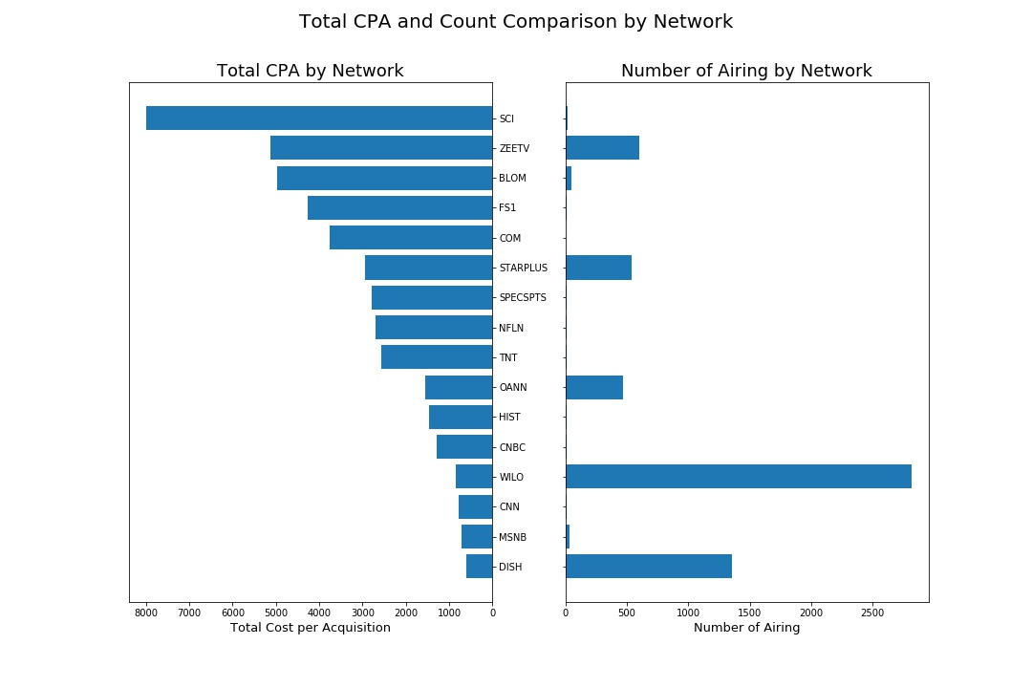
Cost per Acquisition
CPA vs Number of Airing
Cost per Acquisition (CPA) is amount of money spent on each conversion (Spend/Purchase)
CPA also does not seem to correlate with amount of airing
CNN and MSNB seem to give great CPA with low number of airing
SCI and FS1 cost a lot per acquisition, and does not give great CR
CPA of entire dataset
1350.21
Notes:
1350.205685

Slide 18
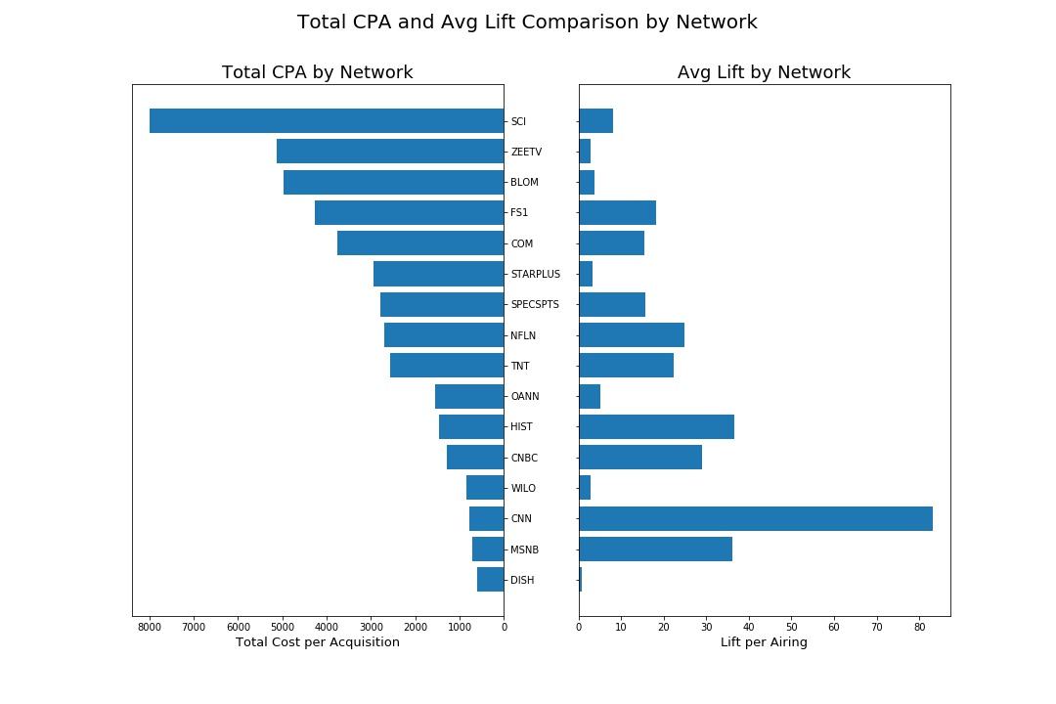
Cost per Acquisition
CPA vs Average Lift
Here we compare CPA with Lift per airing
There seems to be better correlation
More Lift means more visitors to the website who saw the ads
More visitors naturally results in more purchases
Network with large audience, like CNN and MSNB causes more Lift with fewer spending and airing
CPA of entire dataset
1350.21
Notes:
1350.205685

Slide 19
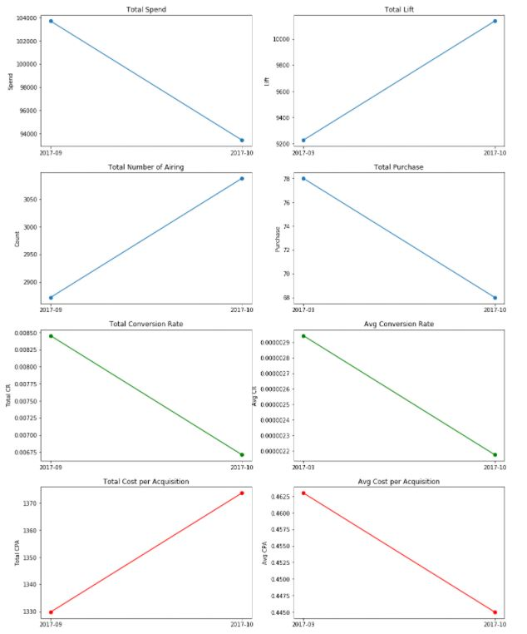
Data by Monthly
Metrics are plotted along time in monthly intervals
Blue - Fundamental Metrics
Green - Conversion Rate
Red - Cost per Acquisition
Since the data was collected only over 2 months, there is not much insight we could draw
This data would be useful if data is continuously collected over several years to give sense of trend
Notes:
1350.205685

Slide 20
Recommendation
Analysis Results
If it does not cost to air, then always air since more number of airing leads to more lift
Although they have weak CR, WILO and DISH usually do not cost much but yields high lift by the shear number of airings, thus providing low CPA
Target mainstream network with large audience
MSNB provides great CR and CPA with relatively low cost per airing and low number of airing
Although average cost per airing of CNN and HIST are relatively high, they provide best CR and some of the lowest CPA. CNN provides highest average lift per airing and highest CR
Avoid high cost, low conversion network
Although COM has high CR, it has the highest CPV and relatively high CPA
SCI and FS1 have two of the highest CPV and CPA, but CR is mediocre
ZEETV has high CPA but low CR
Invest More | Keep Airing | Invest Less
CNN, MSNB, CNBC, HIST | WILO, DISH | COM, SCI, ZEETV, FS1

Slide 21
Recommendation
Survey Questions
First question does not seem necessary if we are only focusing on TV ads
It is okay if planning on advertising on other platform
Make it true/false question to know if the customer watched the ads on TV or not
Second question could be conditional based on the answer to the first question
If first question was true, second question is a mandatory question to prevent blank data
XYZ should have access to the network where their ads were aired
Limit the choices to network they have aired for uniform data across Survey data and Airing data
Let customer indicate when they saw the ads
This provides more accurate link between Survey data and Airing data

